Slide 1
White-Rodgers
50M56X-843 Universal Single Stage HSI Integrated Furnace Control for PSC & ECMx Blower Motors
Introduction

Slide 2
Business and Product Overview

Slide 3
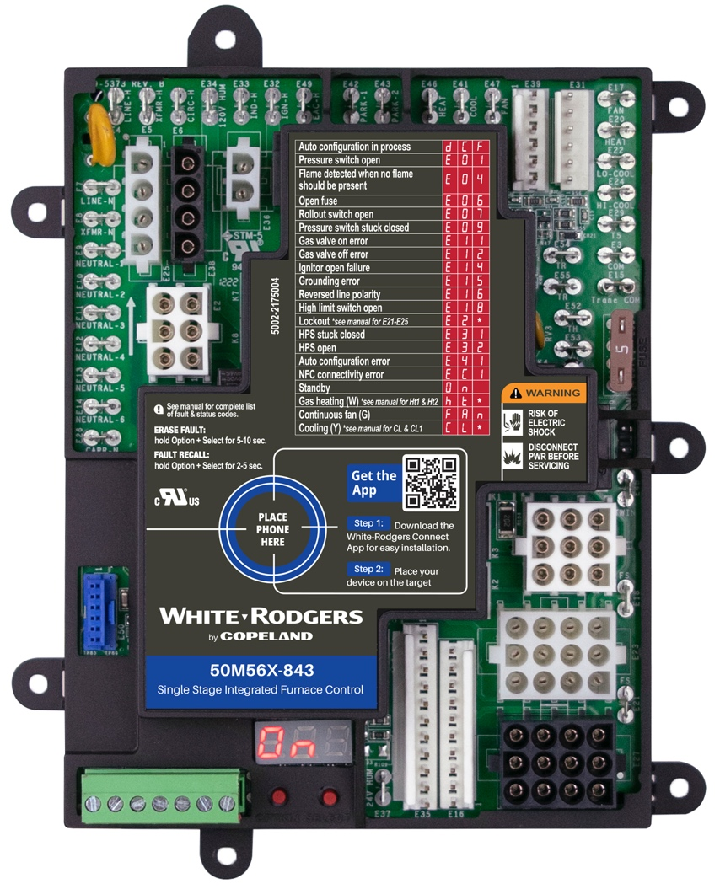
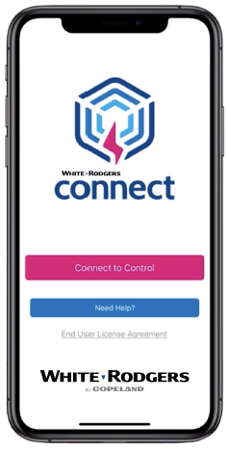
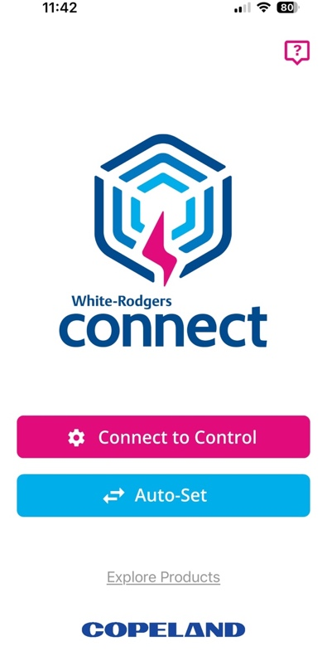
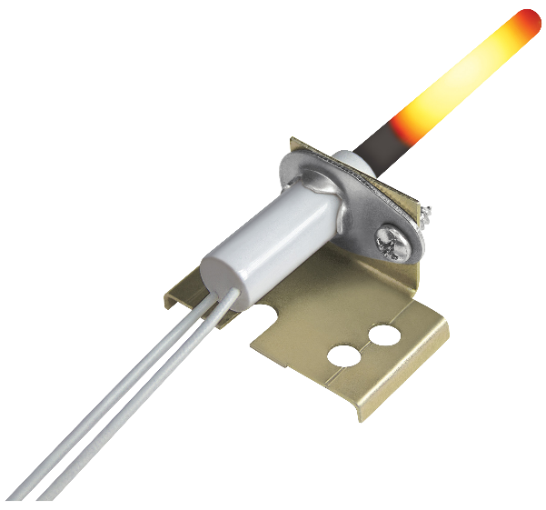
White-Rodgers Universal Replacement Controls
Just Got Better
The White-Rodgers 50M56X-843 Single-Stage PSC
& ECMx Control
  Replaces over 550 single-stage controls, making it the most universal single-stage integrated furnace control available. It combines the 50M56U-843 and the 50X57-843 into one control for both PSC & ECMx blower motors!
  This new control now has the major OEM connectors on the board, eliminating the need for a harness. The single microprocessor oversees all furnace functions including burner and blower operations.
  An included 21D64-2 HotRod 120v Universal Ignitor allows for the control to be used to upgrade an existing 80v ignition control.
  Easy configuration and diagnostics with the White-Rodgers Connect app or the digital led display with option and
  select buttons.

Slide 4
The 50M56X-843 Streamlines Inventory
    Replaces over 550 part numbers ​
    Configurable for both PSC & ECMx blower motors​
    21D64-2 120v HotRod Ignitor included – required for replacing 80v applications​
    Twinning capable​
    120v humidifier, 24v humidifier and 120v electronic air cleaner connections
    Second-Stage cooling & dehumidification options

Slide 5
The 50M56X-843 Simplifies Installation & Diagnostics
    NFC technology allows for easy configuration with the White-Rodgers Connect app
    Digital display provides an alternate method to configure and diagnose control​
    Multiple connectors allow for direct plug-in of OEM harnesses​
    Control auto-detects harnesses plugged in​
    Detachable thermostat bus connector for easy wiring ​
    Multiple control mounting options match OEM’s, including tabs to slide in trays with slots​
    Fault code label on control​
    Live real-time flame current readout

Slide 6

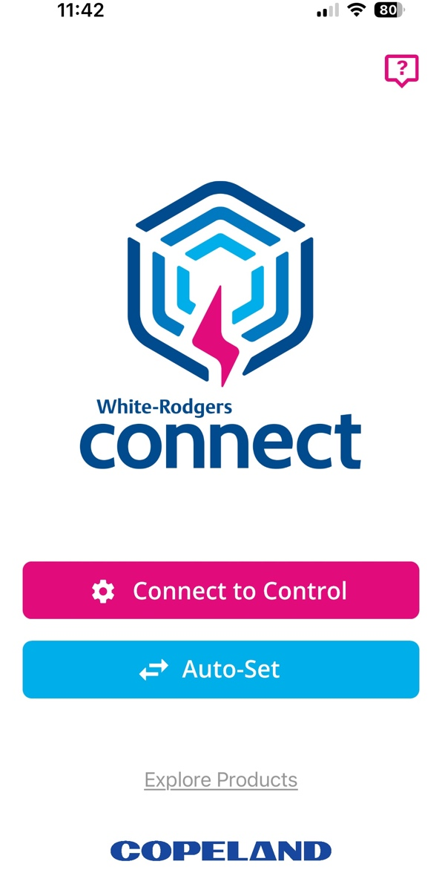
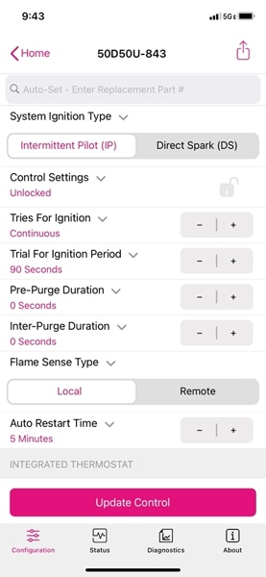
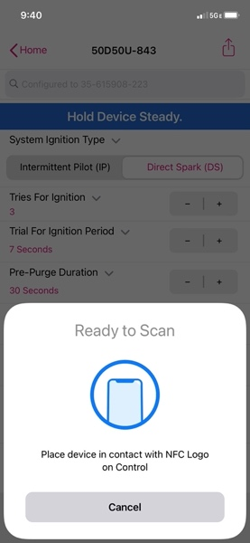
Quick Configuration & Diagnostics with the White-Rodgers Connect App
    App provides simple configuration without power prior to installation
    No login or username required
    Configure with preloaded OEM settings or customize module configurations
    Diagnose fault codes and troubleshoot confidently
    View status and details about the module
Near-field Communication (NFC) creates an interface between the control and your mobile device with the White-Rodgers Connect app. Just place your mobile device on the control to enable a connection.
Once downloaded, the White-Rodgers Connect app does not require cellular/Wi-Fi service to use.

Slide 7
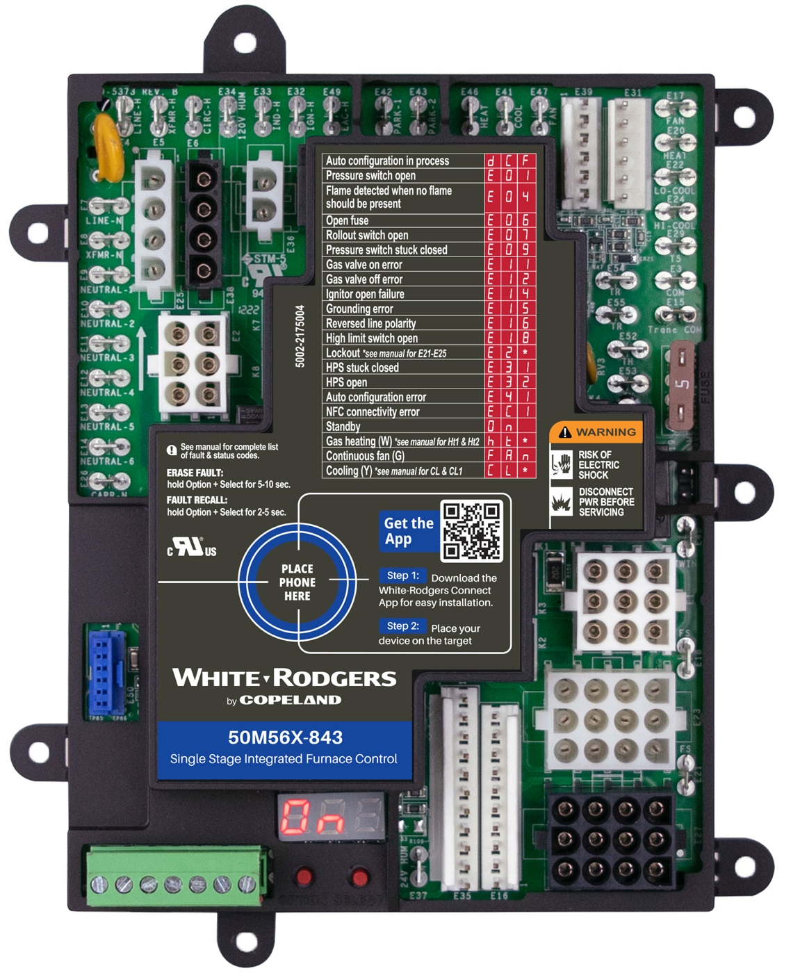

Onboard Major OEM Connectors
Inducer/Ignitor Connectors
ECMx Connectors
    The 50M56X-843 has five main harness connectors, with both In-line and Molex plugs on the same control
    Four inducer/ignitor Molex connectors on-board
    Two ECMx connectors for Trane & Goodman
    direct plug-ins
    Direct OEM plug-in allows for a quick installation with multiple OEM brand controls, simplifying the process and eliminating the need for harness adapters
Main Harness Connectors
TECH TIP: During initial start-ups, the control will perform an auto-configuration sequence that takes approximately 30 seconds

Slide 8
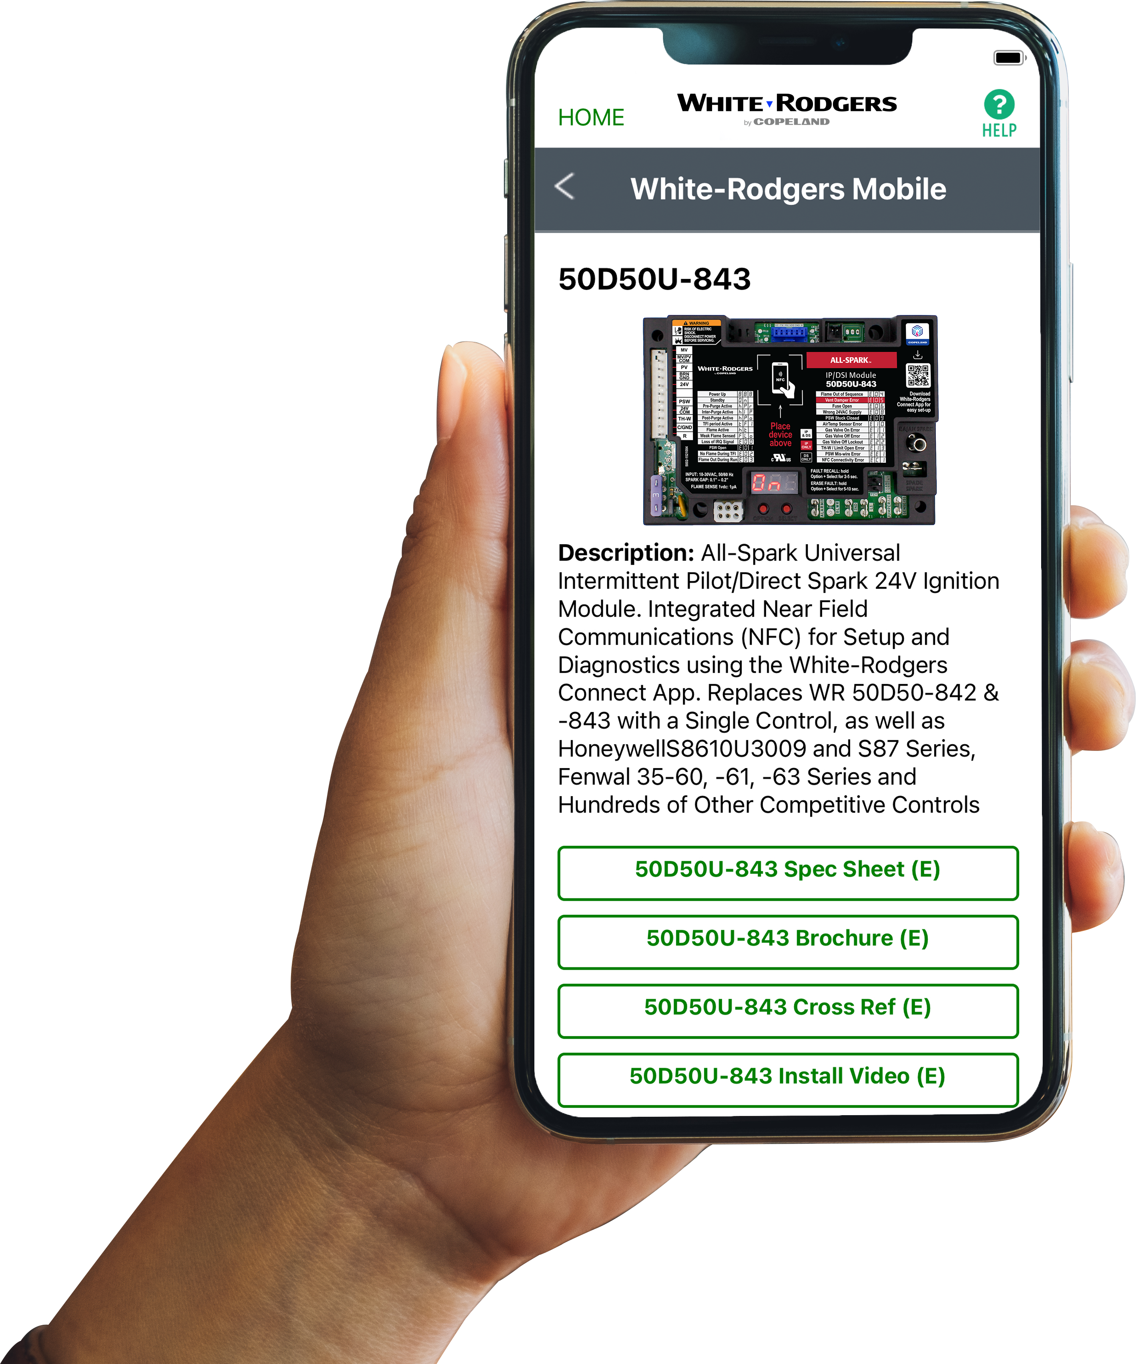



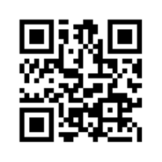
Comprehensive Cross Reference & Product Information
Find the right part while on the job.
  Your on-the-go resource for:
  Complete cross reference
  Product information and spec sheets
  Installation information and videos
  Wiring diagrams
  Select product by features
  Priority technical support
  WR Mobile App
  Search for “WR Mobile” in both Apple
  and Google Play Stores
  Desktop Version
  Access the online version HERE
Search by OEM, Competitor and White-Rodgers part numbers.

Slide 9
Technical Overview

Slide 10
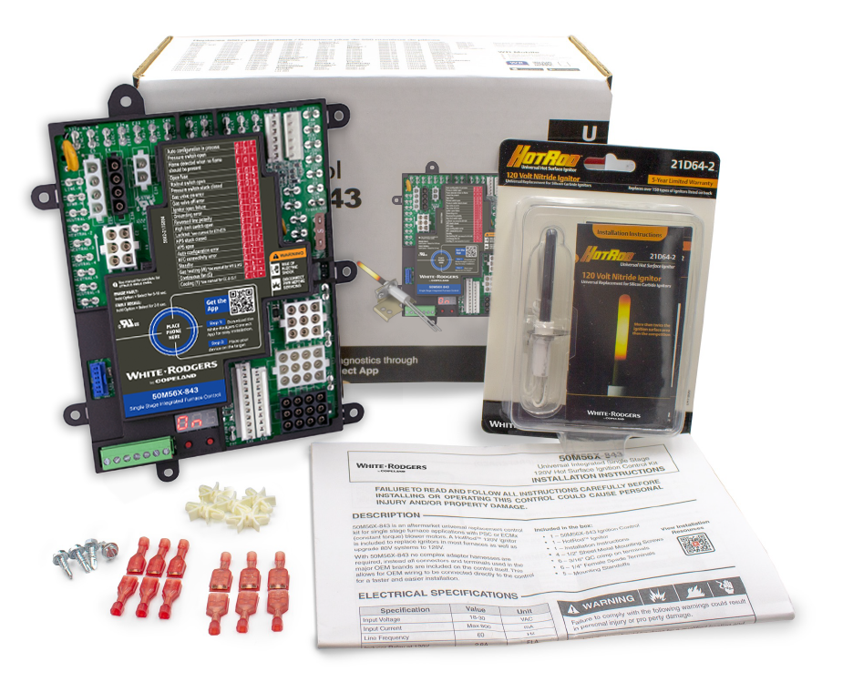
What’s in the Box
List of Contents:
    50M56X-843 Control
    21D64-2 HotRod Ignitor
    4 ½" Self-Tapping Screws
    5 Mounting Standoffs
    6 3/16" Female Spade Terminals
    6 1/4" Female Spade Terminals
    Installation Instruction Sheet
1-Year Warranty

Slide 11
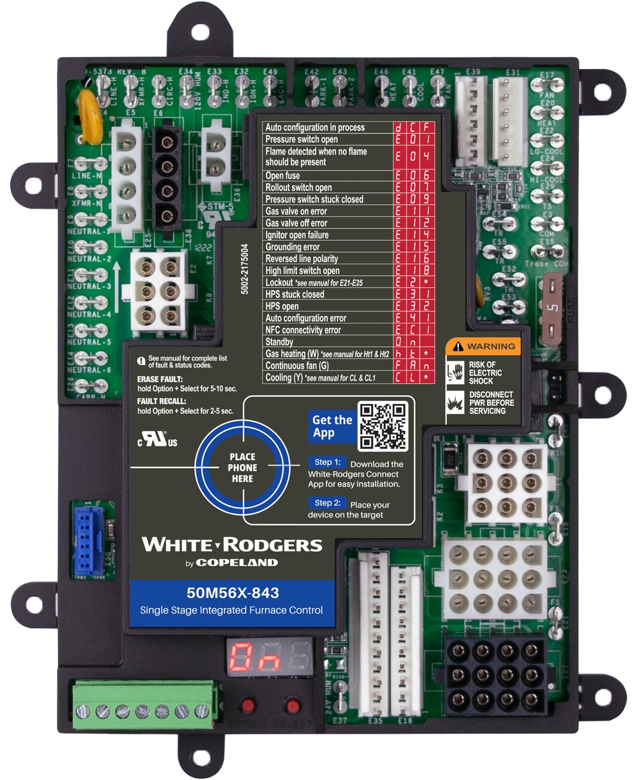
White-Rodgers 50M56X-843 Components
120V Components:
24V Components:
    3/16 Blower Neutral Spade
    6 Line Neutral Spades
    Transformer Neutral Spade
    Line Input Neutral Spade
    4 120v Inducer/Ignitor Molex Harness Plug-ins
    Line 120v Input Spade
    120v Transformer Spade
    120v ECMx Blower Spade
    120v Humidifier Spade
    120v Inducer Spade
    120v Ignitor Spade
    120v EAC Spade
    2 Blower Park Spades
    PSC Blower Heat Spade
    PSC Blower Cool Spade
    PSC Blower Fan Only Spade
7
7
9
11
15
    2 24v ECMx Inline Harness Plug-ins
    24v ECMx Blower Speed Spades
    24v ECMx Blower Common Spade
    24v ECMx Blower Trane Common Spade
    Both 3/16” & ¼” 24v Transformer
    Input Spades
    5a Low-Voltage Fuse
    Twinning Spade
    5 24v Inline/Molex Main Harness Connectors
    24v Humidifier Spade
    24v Removable Thermostat Bus
6
8
10
12
13
14
16
17
4
18
3
5
19
19
2
21
20
22
1
27
23
23
Other Components:
32
33
28
    Flame Sense Test Pins
    1x 3/16" Spade & 1x 1/4" Spade
    Mounting Holes
    Ignition & Blower DIP Switches
    Option & Select Buttons
    Digital LED Readout
    Future Accessory Connector
31
24
28
29
26
30
25

Slide 12
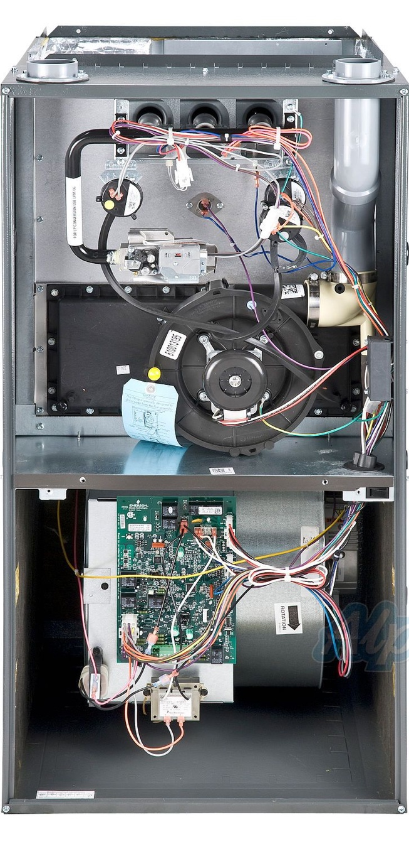
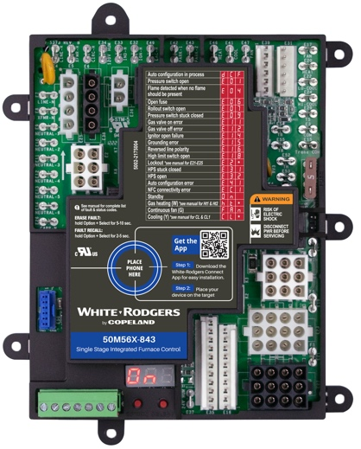
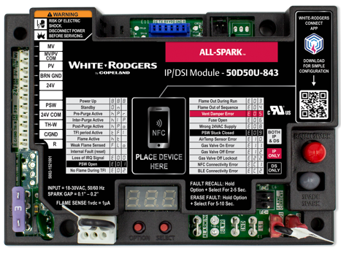
White-Rodgers Controls with NFC
Burner Area Modules
Integrated Furnace Controls
    Configuration only controls burner area settings
  The White-Rodgers 50D50U-843 24v Spark Ignition Module was designed to control the burner area only. The universal control settings that are adjustable deal with the burner section of a furnace only:
    Trial for ignition sequence
    Inducer purge timings
    Flame sense type
Burner Area
    Configuration primarily controls blower area settings
  The White-Rodgers 50M56X-843 Integrated Furnace Control was designed to control the blower area settings:
    Blower motor type
    Blower time delay settings
    Inducer purge timings
Blower Area
Notes:
77777 -=`+36* q q

Slide 13
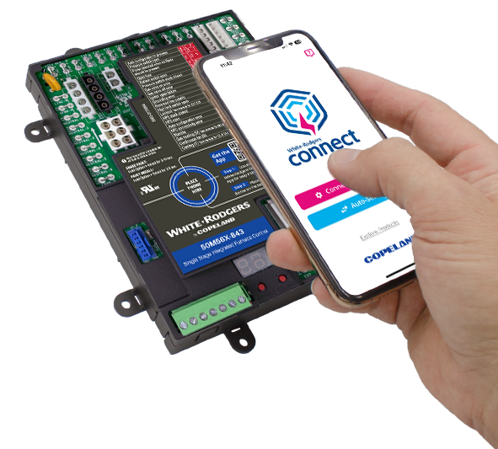
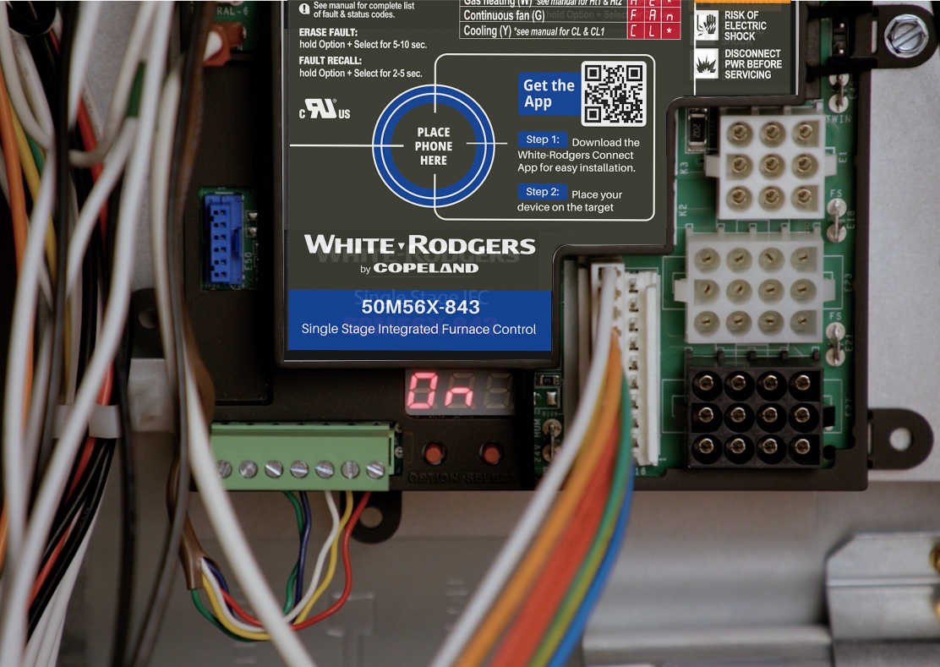
Two Ways to Configure and Diagnose
The Upgraded Design Now Has On-board Programming That Allows for Configuration
Use the White-Rodgers Connect App and Do All the Programming From Your Smartphone
The White-Rodgers Connect app offers the fastest, easiest configuration setup ever!

Slide 14


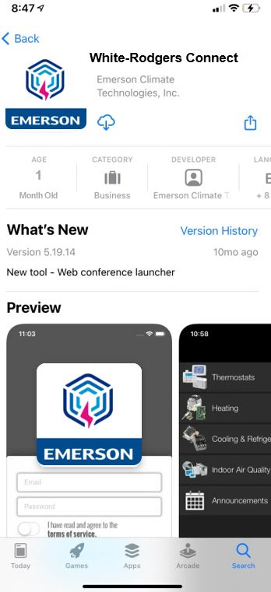
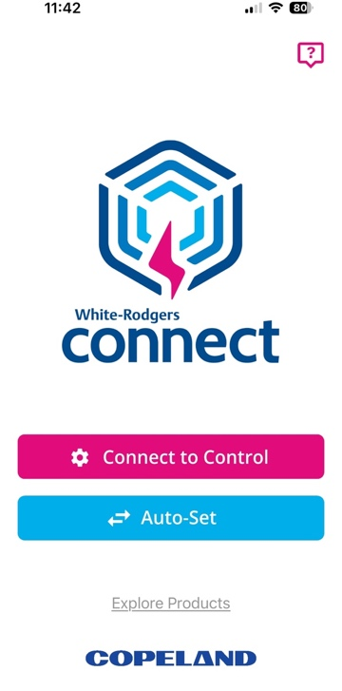
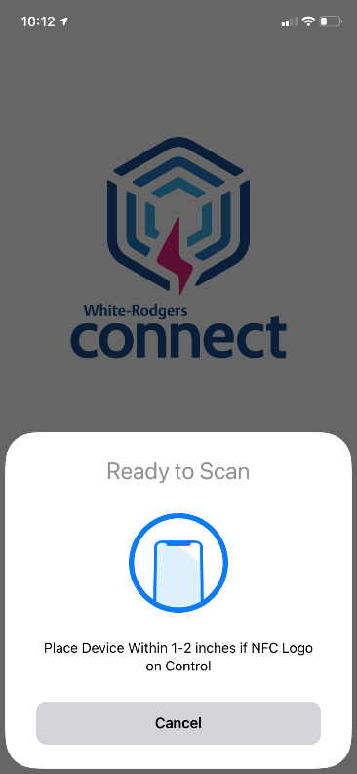



Quick Configuration & Diagnostics with the
White-Rodgers Connect App
Easy Configuration
No Username Or Log-in Required
    App provides simple configuration without power prior to installation
    Configure with preloaded OEM settings or customize module configurations
    Diagnose fault codes and troubleshoot confidently
    View status and details about the module
Download
    Go to your app store
    Type in WR Connect
    Install the app
Download
Connect
Scan
TECH TIP: White-Rodgers Connect app for HVAC replacement control configuration & diagnostics is an industry first!

Slide 15
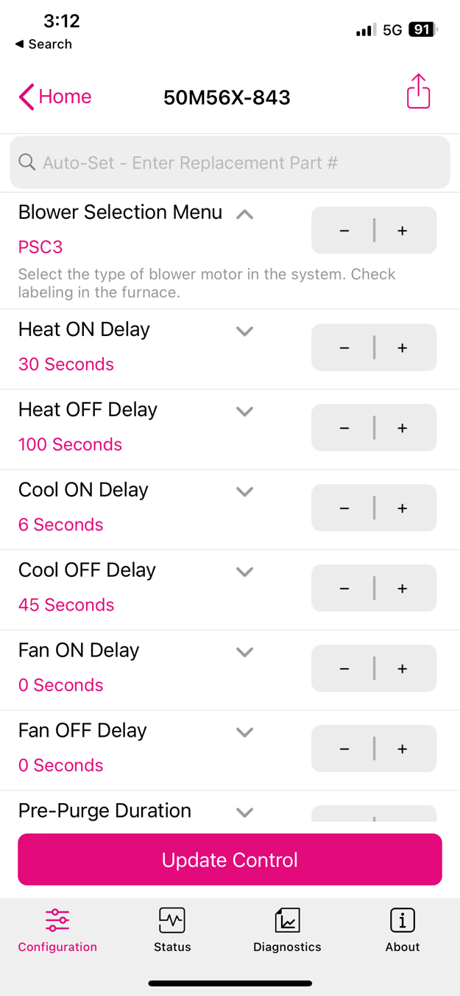
White-Rodgers Connect App Simplifies Configuration and Diagnostics
Enter replacement part number to automatically configure the All-Spark.
    Type the replacement part number into the Configuration tab of the White-Rodgers Connect app to automatically configure the 50M56X-843 universal control to the original default settings for the replacement part number.
    This can be completed without power to the control and before installation.
Intermittent Pilot Setting

Slide 16
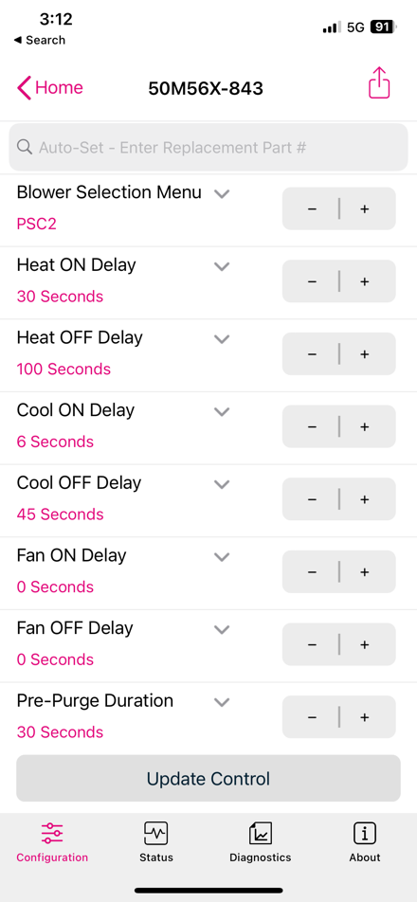
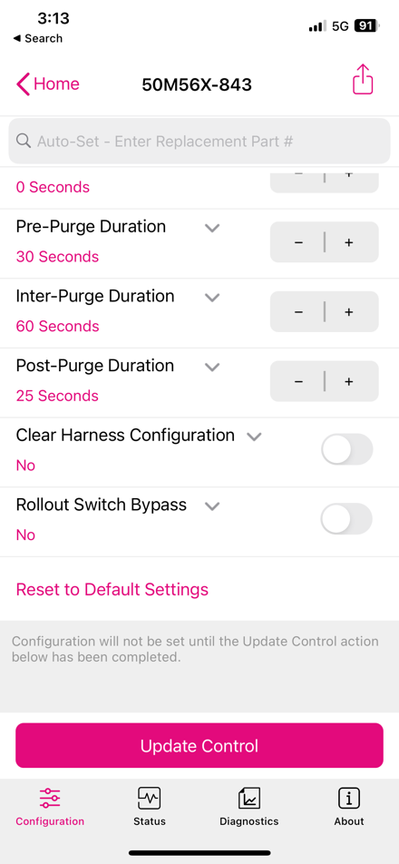
Fully Customizable Configuration Programming in App
Both ignition and blower options are shown in the 50M56X-843 Configuration Settings
Quick Configuration Setup!
    Blower Type
      Select between PSC & ECMx blowers with multiple speed options
    Blower Timings
      Adjust blower heat on & off time
      Adjust blower cool on & off time
      Adjust blower fan on & off time
    Inducer Purge Timings
      Comes set at default for most cross-reference SKU’s. Available for timing adjustments if needed.
Configuration

Slide 17

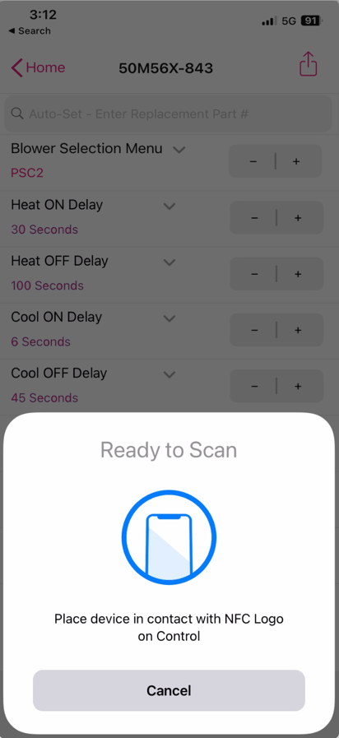
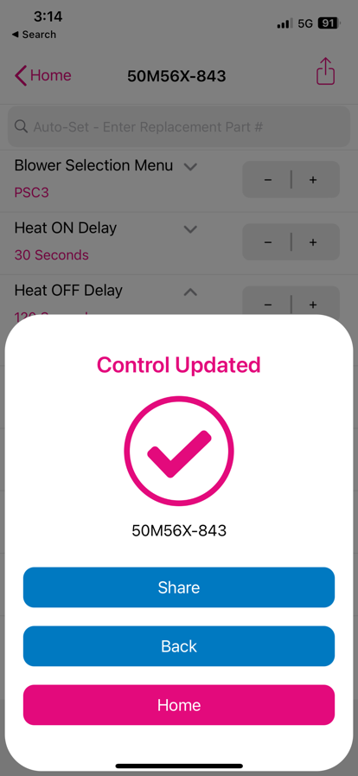
Update Configuration Settings from the App
White-Rodgers Connect
Easy to Update
    After making configuration changes, tap “Update Control” and hold your smartphone over the
    module again
    Once the new configuration is uploaded,
    a confirmation will display
    The settings for the control have been updated.
    You can then share a .txt file via an email or by texting. This .txt file can be printed or stored electronically in a customer's records at the installation company’s office.
It takes 5± seconds to update when holding your phone steady over the module.
Tap
Update
Share

Slide 18
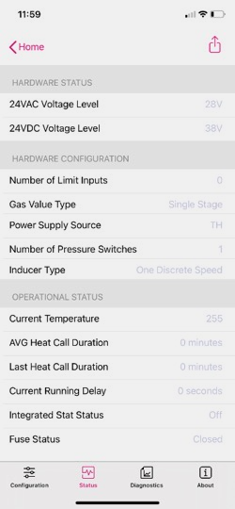
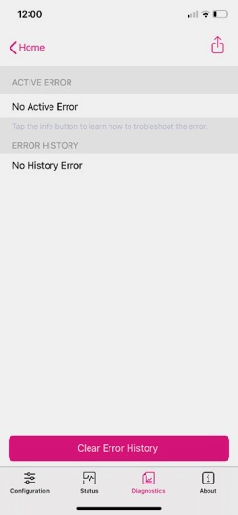
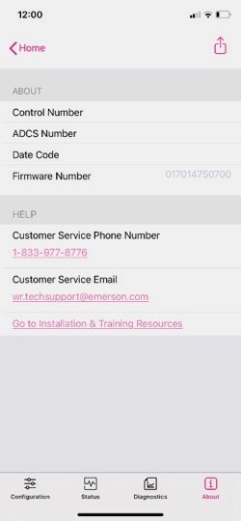
Additional App Features
The app displays all the information shown on the 7-segment display and more!
Status
    See what is going on with voltage, configuration
    and operation
Diagnostics
    Look up current active errors as well as the last five errors that have occurred is the last 14 days
    View troubleshooting tips
About
    Get module-specific information, including the date code and the operating firmware
Tap
Status
Diagnostics
About
Only White-Rodgers gives you all this info on your smartphone!

Slide 19
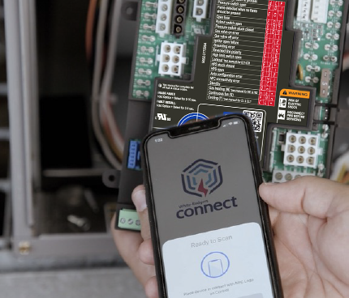
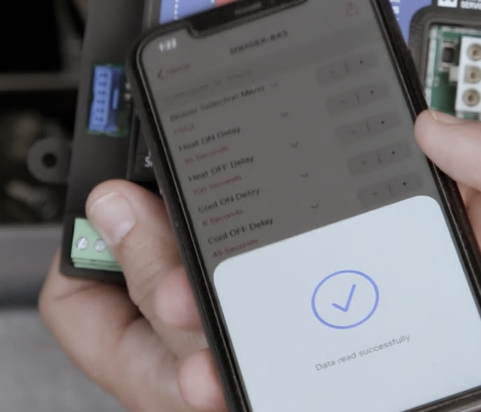
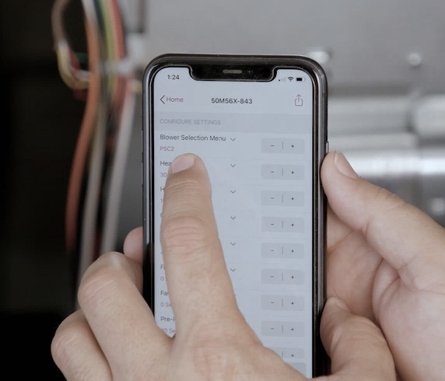
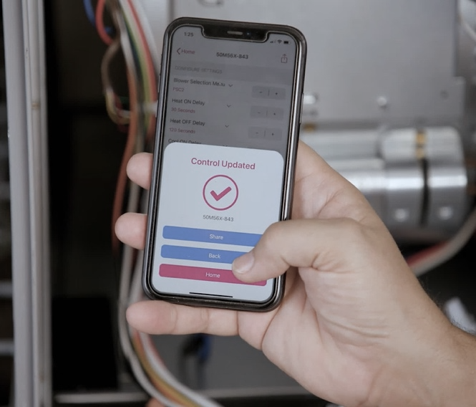
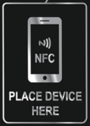
Understanding NFC App Configuration
The control can be powered up to read or update the control, but does not have to be.
If you know the configuration settings ahead of time, they can be uploaded into the 50M56X-843 before leaving
the shop.
No phone service or data connection is required when communicating.
To read, hold the mobile device on the NFC icon for a few seconds until a confirmation check mark appears.
Making changes in the app does not require the mobile device being kept on the control.
Once the control is read, the device can be moved away and easily held to make configuration changes or read control information.
After making changes in the White-Rodgers Connect app, users then must tap the “Update Control” button and hold the device on the NFC icon for up to ±5 seconds while the data packets upload.

Slide 20
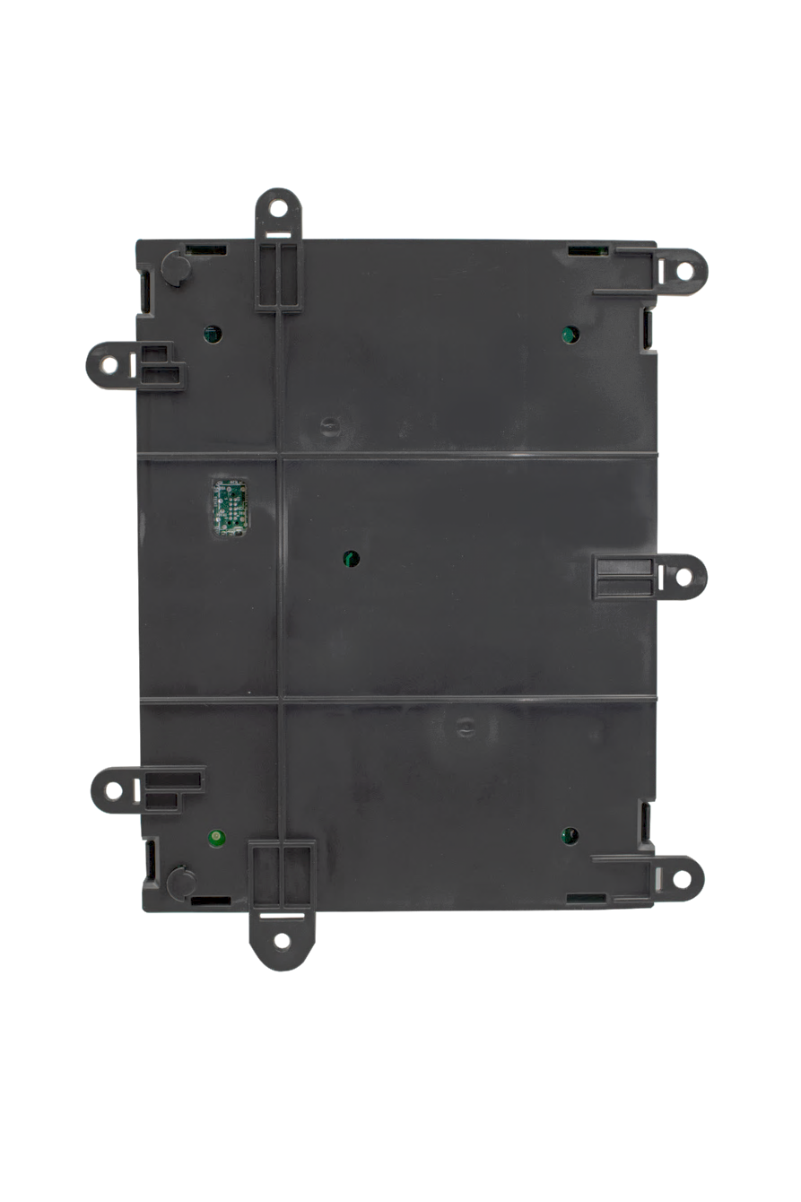
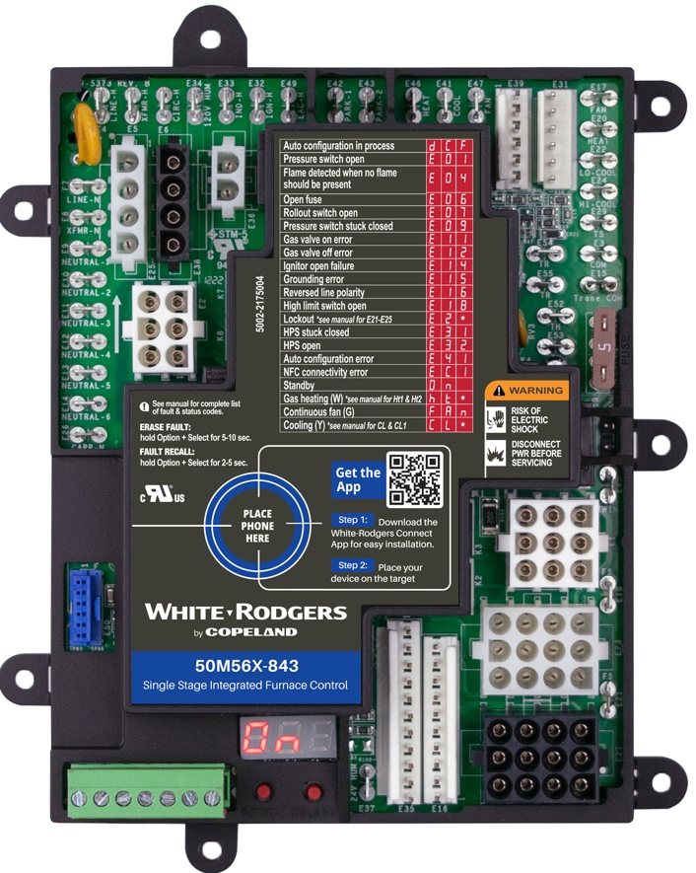
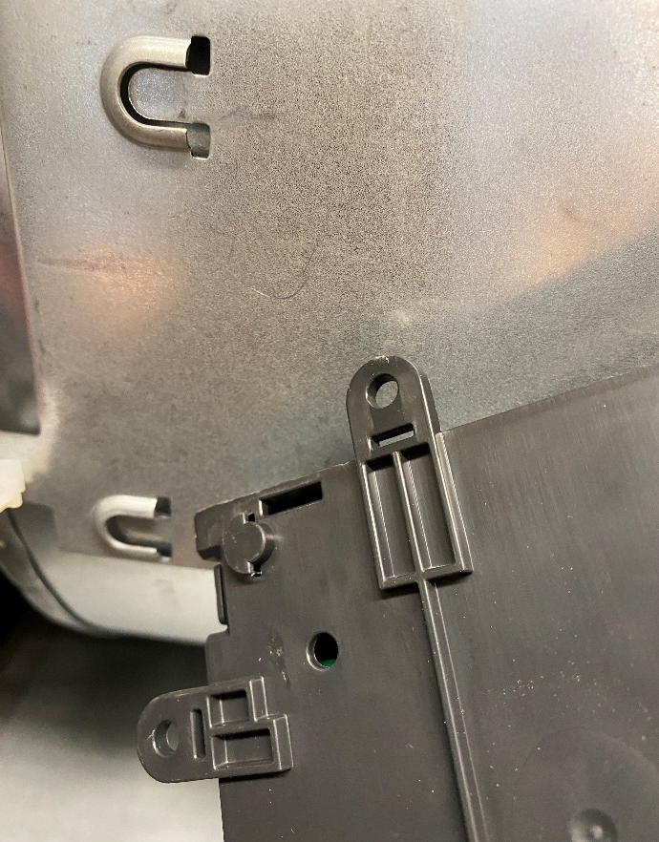
Three Easy-to-Install Mounting Options
Seven Mounting Tabs
Five Standoff Holes
Two-slot Slide-in Tabs
  4 ½" self-tapping screws are supplied for multiple mounting options.
  White-Rodgers’ molded tray base provides space between the board and the unit mounting plate. Five standoffs are included for snap-in mounting.
  Utilize existing slots by using slide-in tabs molded into the tray.

Slide 21
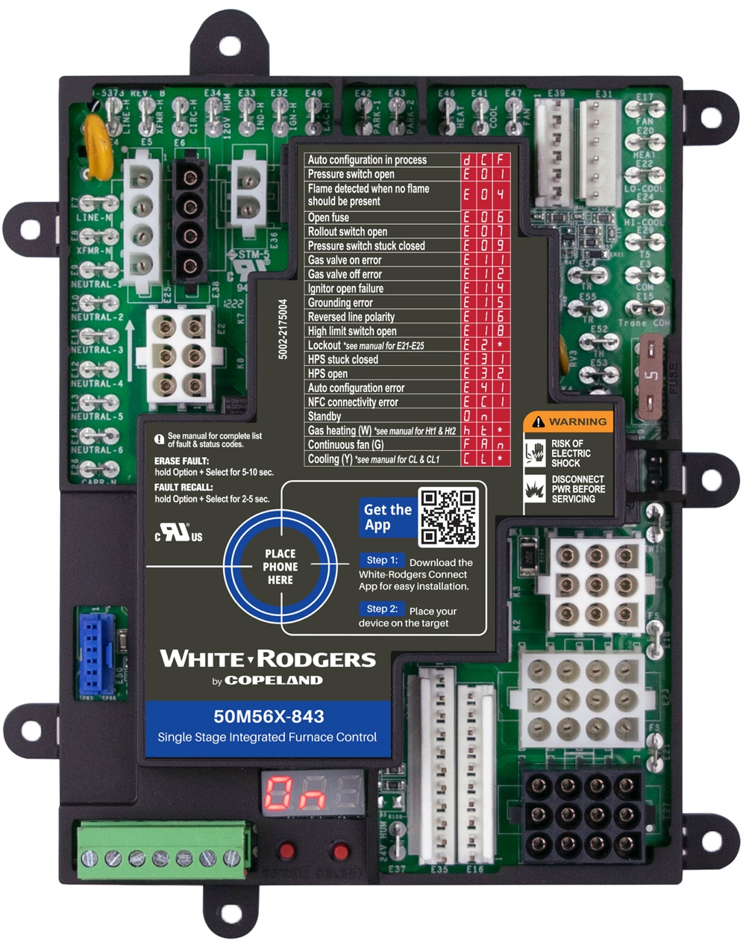
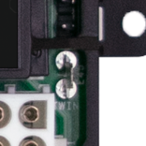
Twinning Feature
    Two 50M56X-843 controls can be connected to operate simultaneously.
    Twinning requires a connection of the twin terminal on both boards using an 18ga wire.
    The board with the thermostat connection will fully function, including the LED indicator and DIP switch settings. The twinned board will operate simultaneously as determined by the wired board unless “W” or “Y” are powered to it.

Slide 22
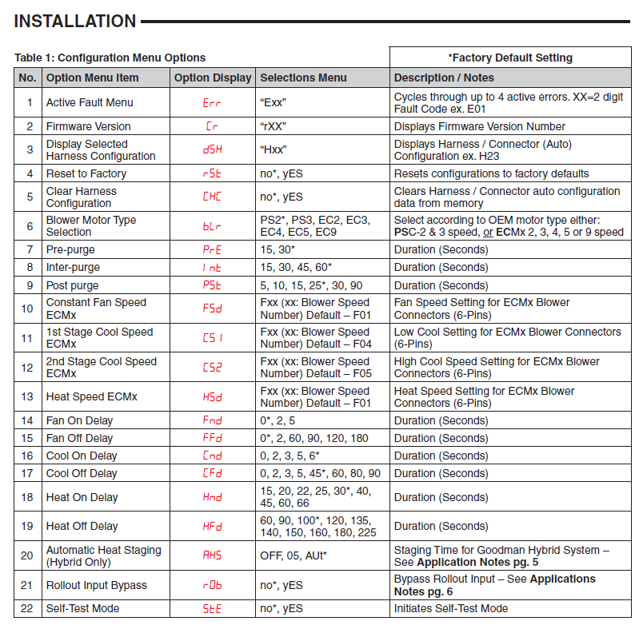
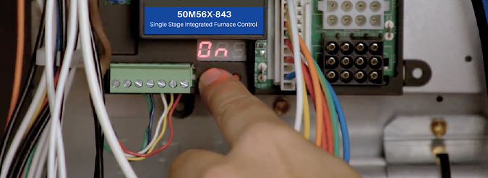
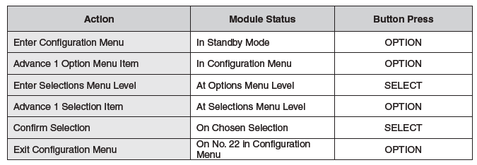
Easy On-board Setup Configuration
Configure Using the Option & Select Buttons
    After the system is powered on, the display will read ON when in standby mode. To enter setup, press the “Option” button.
    Refer to the installation instructions on page 2
    for details on how to navigate the "Option" and "Select" buttons.
  Match blower timer settings to the old control being replaced.

Slide 23
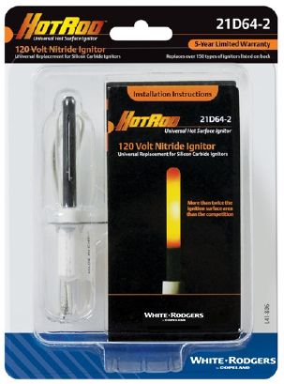
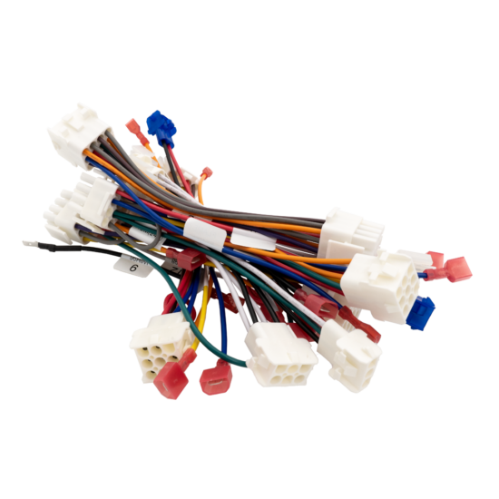

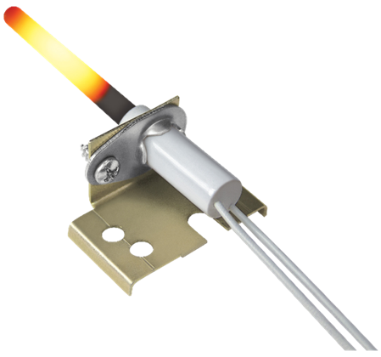

Universal Applications
80V Ignitor Controls
Blower Type Selection
Replacing Existing Universal Controls
  80V ignition systems that must be upgraded to 120V by replacing the OEM ignitor with the included HotRodTM ignitor. See the installation instructions on page 5 or verify with WR Mobile for cross-reference numbers that apply.
  With the 50M56X-843 able to replace both PSC & ECMx blowers, configuration must be set to the type of motor as well as the quantity of speeds.
  The Configuration Menu setting #6 (bLr) must be set to match the equipment's blower.
  When replacing a failed Resideo/Honeywell H9200U1000, ICM ICM2812-KIT & ICM-2812, or White-Rodgers 50M56U-843 & 50X57-843, identify and remove any wiring adapter harness between OEM furnace wiring and the failed universal control prior to installing a 50M56X-843.

Slide 24
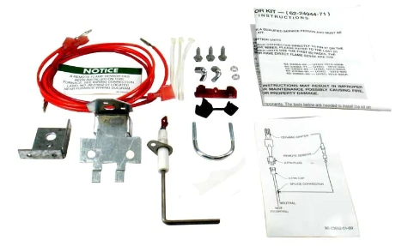
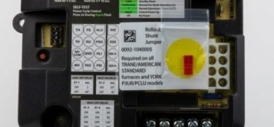
Special Case Applications
Goodman Hybrid
2-Stage
OEM Wiring Connectors
Roll-Out
Configuration
Flame
Sensor Kit
A unique system known as the “Goodman Hybrid” system is a furnace with a two-stage gas valve paired with a single-speed inducer motor and a single stage blower.
50M56X-843 is able to operate these unique applications with the following cross-reference controls:
Some OEM furnaces, for example Trane and American Standard have a plastic connector housing that groups together line and neutral spade terminals.
When found, remove the block and install the supplied quick-connect spade terminals.
Certain Trane, American Standard, and York (including York P3UR/PCLU) furnaces
do not have an individually monitored rollout switch in
their main harness wiring configuration.
No shunt or jumper is now required.
The Configuration Menu setting #21 (rOb) to (yES) will digitally bypass the rollout input.
If the 1994 or earlier Rheem/Ruud control being replaced has two green lights (no amber light) and a date code of 3294 or earlier, a Flame Sensor Kit, RHEEM part number 62-24044-71, required (not available through White-Rodgers).
Goodman Controls
PCB00109 | PCBBF109
PCBBF109S | PCBBF122
PCBBF122S | PCBBF132
PCBF132S

Slide 25
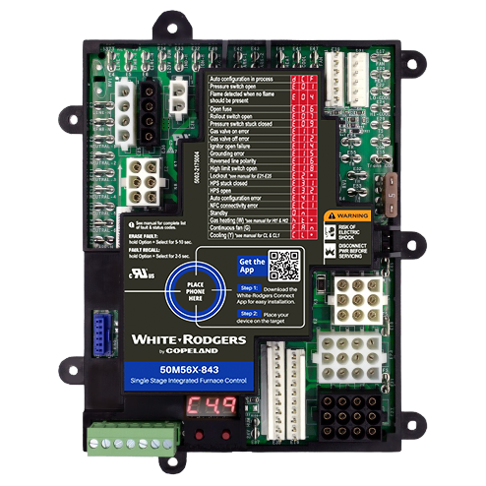
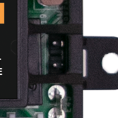
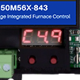
Get Flame Current Reading Without Meter
NEW On-Board Read-out
  During a call for heat when a flame is present, the digital display will display the flame sense in Microamps.
  No more needing to pull out a meter to get a Microamp reading–just look at the display!
  Standard Test Pins Also Available
  Two pins can be found on the right
  edge of the control board.

Slide 26
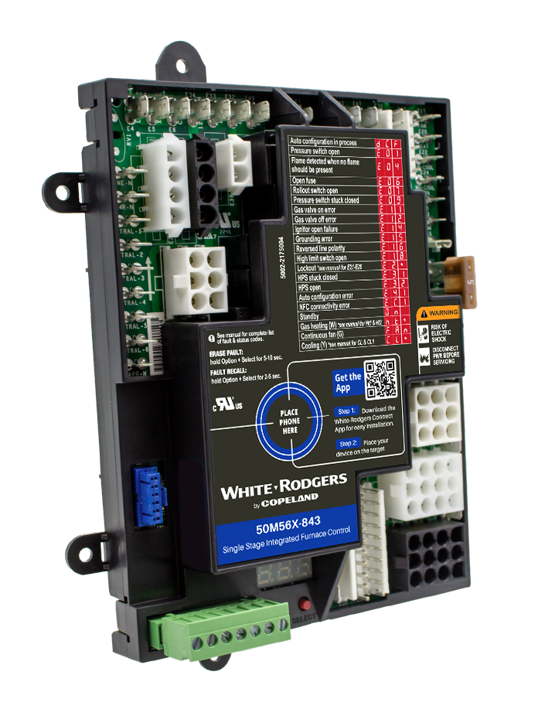

Thermostat Wiring Made Easy
Lift-off Thermostat Connector Block, Including Dehumidification
    Connect thermostat wiring away from the board
    No more getting into the furnace to get the wiring connected–just connect it out front, verify wires are secure in the block, then plug in!
    When the dehumidification terminal on the block is used, the control will slow the blower down during cooling for increased humidity removal.

Slide 27




Onboard Status & Fault Codes for Troubleshooting
2
    Easy-to-see digital display shows fault/error conditions
    Troubleshooting is simplified with a fault code/status label on the control cover
The Option & Select Buttons Allow For:
    Menu configuration
    Recall of the last five faults
    Fault code erasure
1

Slide 28
Universal Integrated Furnace Controls
Competitive Comparison
White-Rodgers Has More Features
Feature | Resideo / Honeywell S9200u1000 | Icm Icm2812-kit | White-rodgers 50m56x-843
Stages / Blower Types | 1 - PSC Only | 1 - PSC Only | 1 - PSC & Ecmx
Mobile App, NFC, BLE* | No | No | Yes – WR Connect
Harnesses | 8 | 11 | None – OEM Harness Detected
Cross-references | 200+ | 150+ | 550+
Ignitor Voltage Serviced | 120V Only | 120V Only | 80v & 120v
Includes Universal Ignitor | No | No | Yes
Configuration Options | Limited - 4 Dipswitches | Limited - 2 Dipswitches | Unlimited App Or Push Buttons
LED Displays | Tri-color LED Light | Red LED Light | Digital LED Display
Rollout Accessory | Difficult Wire Jumper | Difficult Wire Jumper | Not Required
Flame Current Test | No | No | Digital Readout Or Test Pins
Full Cover W/ Fault Code Label | No - Tray Only | Yes | Yes
Fault Recall & Clearing | Jump R & D Terminals | Push Button | WR App / Push Buttons
Status & Diagnostics | Count LED Flashes | Count LED Flashes | Read On Display Or App
Humidifier Output | 120V Only | 120V Only | 24V Or 120V
2nd Stage Cooling & Dehumidification | No | No | Yes

Slide 29



50M56X-843 Benefit Summary
Auto Harness Detection
Fast Configuration
NFC Setup & Diagnostics
  Say goodbye to a bundle of harnesses!
  With harness auto detection, no adapter harnesses are needed
  to connect a furnace to the 50M56X-843!
  No more manually going through manual DIP switches.
  Using the WR Connect app or the on-board three-digit, seven-segment digital display, all settings can be quickly accessed.
  Near-field communication controls can quickly and easily be configured in the palm of your hand and directly uploaded into the control.
  Diagnostics can be seen
  at a glance!

Slide 30
Installation Overview

Slide 31

Disconnect Power and Gas
1
  First, ensure power and gas are disconnected prior to servicing the unit.

Slide 32



Check the Part Number on the Existing Control
2
  Check the part number on the existing control and verify it is one of the more than 550 modules that can be replaced with the 50M56X-843.

Slide 33

Take a Picture of Wiring
3
  Take a picture of the existing module for reference before removing any wires.

Slide 34

Disconnect the Thermostat Wiring
4
  Disconnect the thermostat wiring. Take note of what color wires are going to each terminal. Continue removing the rest of the wires in groups.

Slide 35

Remove the Board
5
  Remove the board by unscrewing any screws
  and disconnecting any standoffs holding the board in place.

Slide 36

Configure the Board
6
  On-board configuration can be done after the board has been installed and powered up.
  Mobile app configuration is the preferred method, and can be done prior to installing the control.

Slide 37

Mobile App Configuration – Download the App
6
  Use the QR code on the product label to download the White-Rodgers Connect app.

Slide 38


Mobile App Configuration – Connect to Control
7
    Open the app and tap on “Connect to Control”.
    Place the mobile device in contact with the NFC logo on the control.
    A check mark will appear showing the connection was successful.
    The app will then display the 50M56X-843’s configuration screen.

Slide 39


Mobile App Configuration – Adjust Settings
8
    Auto-set: enter replacement part number to configure to preloaded OEM settings
    Settings can be adjusted to match the existing control
    Additional configuration options may pertain to your specific application
    Reference the instruction manual for a complete list of configuration options

Slide 40

Mobile App Configuration – Upload to Control
9
    Select “Update Control”
    Hold the mobile device near the NFC logo
    A check mark will display showing the update was successful

Slide 41

Mounting Options
10
  The control has seven mounting tabs, five standoff holes and two slide-ins.

Slide 42

Mount the Control
11
  Use the mounting that matches the existing control, if possible.
  Make sure you don’t damage any components, such as wire harnesses or blower wheels, when drilling or installing screws.

Slide 43


Wiring the New Board
12
    Identify the main connector on the OEM wiring harness
    Attach it to the matching connector on the new control. Attach the 11-pin connector.
    Use the wiring diagrams in the installation instructions for proper OEM connector and wire identification

Slide 44


Wiring the New Board
13
  For six-pin ECMx applications, identify the correct connector on the control and plug in the ECMx motor harness.
  For ECMx spade terminal applications, plug the motor wires on the matching terminals.

Slide 45

Wiring the New Board–Special Case Application
14
  For OEM wiring using a plastic connector to group together 112V power and neutral terminals, cut the wires near the housing and install the supplied quarter–inch quick–connect spade connectors.

Slide 46

Wiring the New Board – Special Case Application
15
  The three 120V line wires can be connected to the Line H, transformer H and C I R C, in any order.
  Connect the three neutral wires to the Line N, Transformer N and Neutral 1 terminals.

Slide 47

Wiring the New Board – Most Applications
16
  Connect the individual wires to the new
  control board.
  Connect the line-in 120V power and transformer wires. Then connect the 120V neutral and transformer neutral wires.

Slide 48


Wiring the New Board – Most Applications
17
  Plug in the two wire Molex plug for the inducer and ignitor. Connect the PSC blower wires: heat, cool, park and neutral.
  Identify the correct spade size for the 24V hot and common wires and attach the transformer low-voltage wires to the correct terminals.

Slide 49

Wiring the New Board – Most Applications
18
  Remove the thermostat bus block from the control and install the thermostat wires according to the terminals they were removed from.
  Then plug the block back into the control.

Slide 50

Check the Ignitor
19
  If the control being replaced operated an 80V ignitor, the existing ignitor must be replaced with the included Hot Rod ignitor.
  For all other applications, inspect the existing 120V ignitor to determine if it must be replaced.

Slide 51

Ready to Test – Reconnect Power and Gas
20
  Reconnect the electric power and gas to the unit
  Make sure the door switch is engaged
  .

Slide 52

Automatic Harness Configuration
21
    The 50M56X-843 automatically configures
    the control to match the harnesses that have been attached
    The process takes up to 30 seconds at first power-up
    After two consecutive matching power-ups, the control will write the configuration in memory
    See the installation instructions if the control needs to be reset for a different application

Slide 53

Self-Test Mode
22
  “Self-test” mode allows the control to test most furnace components without requiring a call for heat.
  To enter the self-test mode, go into the configuration settings and choose “YES” on option number 22.

Slide 54

Self-Testing
23
  The system first tests the inducer, then tests
  the igniter to make sure that it is wired and connected correctly.
  During an active call for heat, cool or constant fan, the LED display will alternate between up to three status indicators.

Slide 55


Make a Call for Heat
24
  When you make a call for heat the control will show “Heat” mode.
  The inducer will start and the control will show that is in the heat mode and is doing a pre-purge with the inducer.
  The furnace will go through a 30-second pre-purge first. Then after that we will start our trial for ignition.

Slide 56
Verify Proper Ignition
25
  The trial for ignition will show ignition on the LED. When lit, a signal is sent through the flame sense probe to indicate that ignition has occurred.
  In heat mode, the display will rotate through several different display readings, including heat and then C and a number, indicating that the flame probe is sensing those Microamps in the circuit.

Slide 57

Active Error
26
  If incurred, the active error will show on the display. The error can be referenced on the label so you know exactly what to look for when an error occurs from the control display.

Slide 58

Finalize Tests
27
  Finalize any tests you would like to complete.
  Terminate the call for heat.

Slide 59
Fault Code Errors: On Furnace Control
28
  Fault code errors can be recalled through the White-Rodgers Connect mobile app or onboard the equipment.
  Press "Option" and "Select" buttons for two to five seconds to find a fault that has been stored. The unit will show any errors that have occurred.
  To clear any fault codes, press and hold the, "Option" and "Select" button together for five to ten seconds until the display will read, ”clear faults."
  The history will be cleared out of the control. If a fault occurs, it naturally clears after 14 days.

Slide 60




Fault Code Errors: WR Connect
29
  Open the app and select the “Connect to Control” button. Place the mobile device near the NFC logo on the module and wait until a check mark appears showing the connection was successful.
  The app will then display the module’s settings configuration page. To see any errors, select the Diagnostics tab. Errors will be listed with the most current at the top.

Slide 61

Fault Code Errors
30
  For detailed information and troubleshooting tips, select the arrow by the fault.

Slide 62

Fault Code Errors
31
  To clear errors in the app, tap the "Clear Error History" button.
  Place the device in contact with the NFC logo on the module and wait for the check mark to appear.
  This action can be performed whether the module is powered on or powered off.

Slide 63

Details of This Control
32
  Click the About tab to get details about the control and customer service information.

Slide 64

Thank you.
R-5648. ©2024 Copeland LP.

